Slide 1
ML-Powered Personalized Stress Management
A Web-Based Real-Time Framework with Gradio and Secure Access
Submitted in the partial fulfillment for the award of the degree of
BACHELOR OF ENGINEERING
IN
Computer Science Engineering (IOT,AIML)
Submitted by:
Baby Monal (21BCS4526)
Sehajpreet Kaur (21BCS4518)
Ravikumar Sivalinga (21BCS6492)
Under the Supervision of:
Ms. Geeta Rani
Department of AIT-CSE
DISCOVER . LEARN . EMPOWER

Slide 2
Outline
Introduction to Project
Problem Formulation
Objectives of the work
Methodology used
Results and Outputs
Conclusion
Future Scope
References

Slide 3
Introduction to Project
Problem Statement: Stress is a widespread issue that negatively affects both mental and physical health, leading to decreased productivity and overall well-being.
Limitations of Traditional Methods: Conventional stress management often relies on costly or inaccessible professional care, lacking scalability and personalization.
Need for Innovation: There is a growing demand for affordable, real-time, and personalized stress management solutions.
Proposed Solution: This project introduces a Machine Learning-based system using the Random Forest algorithm to predict and classify stress levels based on user input.
User-Centered Design: The solution leverages behavioral analytics to generate personalized stress-reduction recommendations.

Slide 4
Introduction to Project
Interface: A user-friendly Gradio-based interface enables smooth user interaction and immediate feedback.
Visualization Tools: Stress trends are tracked and displayed via interactive charts, allowing users to monitor stress changes over time.
Security Measures: The system ensures secure user authentication to protect sensitive personal data.
Scalability & Flexibility: Designed for continuous use, the platform adapts to changing stress patterns and supports long-term engagement.
Goal and Impact: The aim is to provide an accessible, data-driven tool that empowers users to manage stress effectively, promoting improved mental health and productivity.

Slide 5
Problem Formulation
Stress is a growing concern that significantly impacts mental and physical health, productivity, and overall well-being. Traditional stress management approaches often rely on:
In-person counseling
Expensive treatments
Lack of real-time adaptability
Limited scalability and personalization
Key Problems Identified:
No immediate, accessible support for stress detection
Existing ML-based solutions lack user-specific advice
Many systems depend on physiological sensors, reducing scalability
Absence of secure, private, and interactive platforms for stress tracking

Slide 6
Objectives of the Work
To develop a machine learning model using the Random Forest algorithm that accurately predicts and classifies user stress levels based on behavioral and self-reported data.
To design an interactive Gradio-based interface that allows users to input responses, receive real-time feedback, and engage with the system easily.
To generate personalized stress-reduction recommendations tailored to each user's stress classification and behavioral patterns.
To visualize stress trends over time using charts and graphs, helping users understand fluctuations in their stress levels and encouraging regular monitoring.
To implement secure user authentication for protecting personal data and ensuring a trustworthy and private user experience.

Slide 7
Methodology used
1. Data Collection
User inputs collected via a web interface (Gradio)
Lifestyle and behavioral parameters (e.g., sleep, hydration, stress sources)
2. Data Preprocessing
Handled missing values using Pandas
Converted categorical data using Label Encoding
Standardized inputs for model compatibility

Slide 8
Methodology used
3. Machine Learning Model Algorithm Used: Random Forest Classifier
Handles both numerical & categorical data
Reduces overfitting using bagging and random feature selection
Trained with 80/20 train-test data split
4. Web Deployment Tool Used: Gradio
Enables real-time, user-friendly interaction
Allows users to input data and receive instant predictions
5. Authentication & Visualization
Password-protected admin panel for secure data access
Visualization of stress trends using bar plots and trend charts

Slide 9
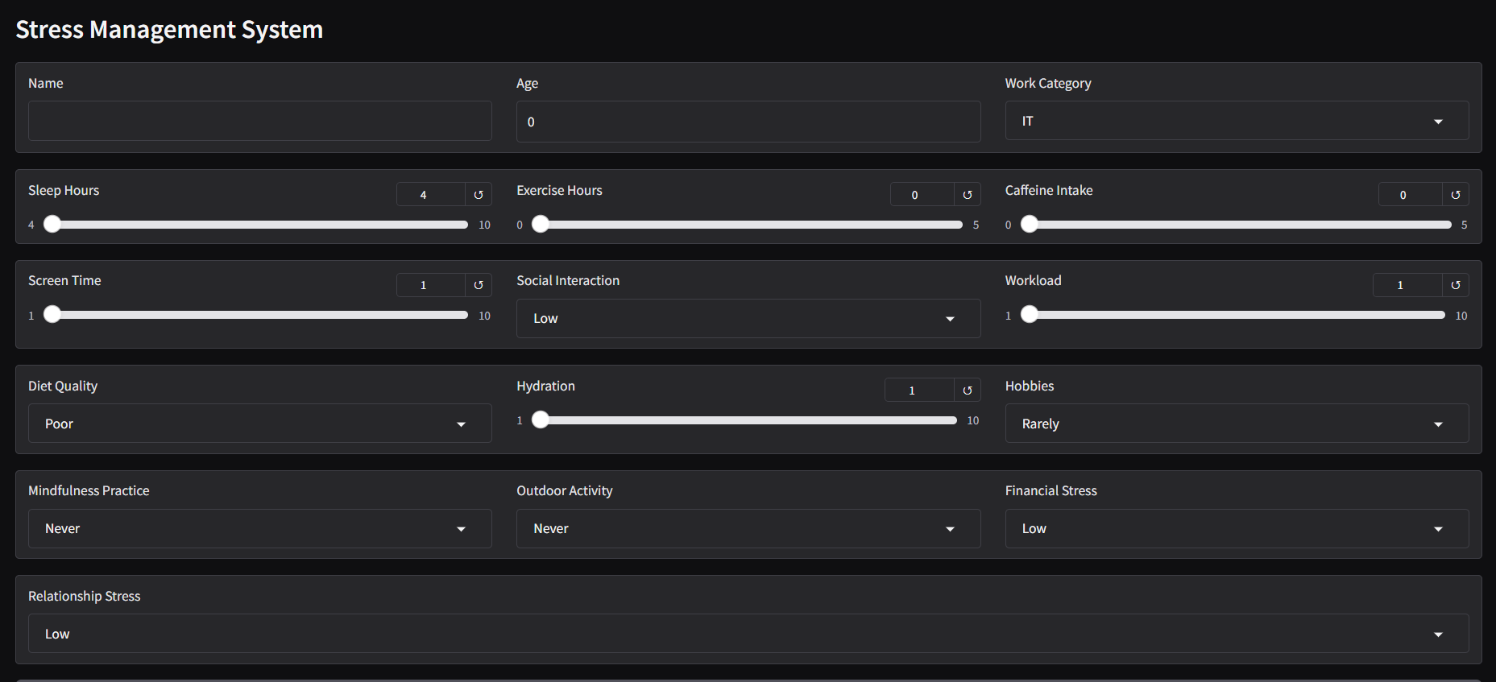
Results and Outputs(INTERFACE)

Slide 10
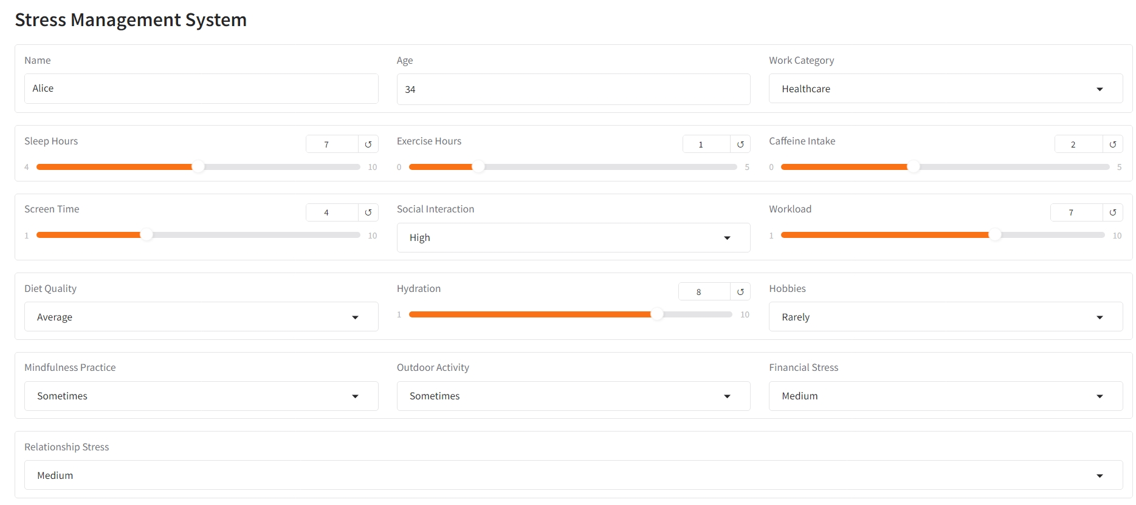
Results and Outputs

Slide 11
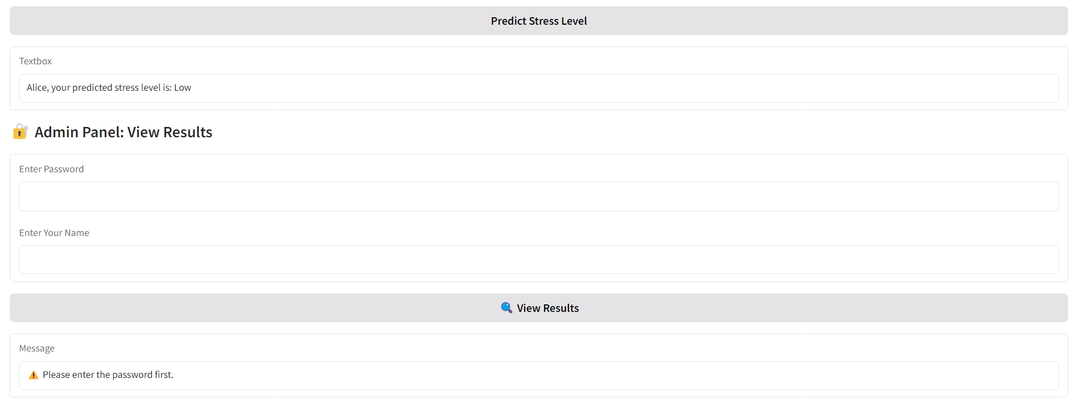
Results and Outputs
ADMIN PANEL

Slide 12
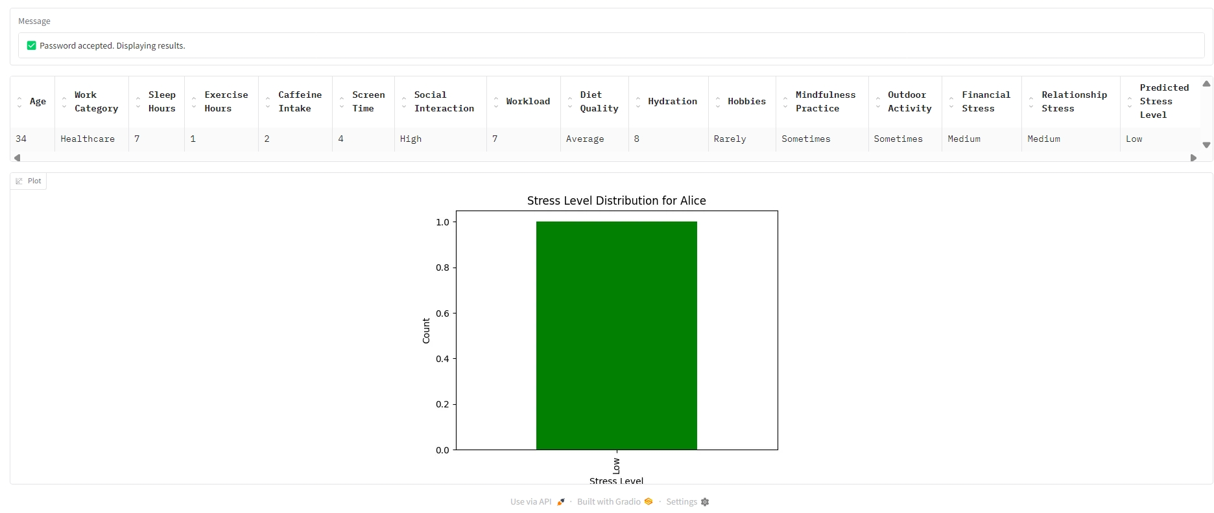
Results and Outputs

Slide 13
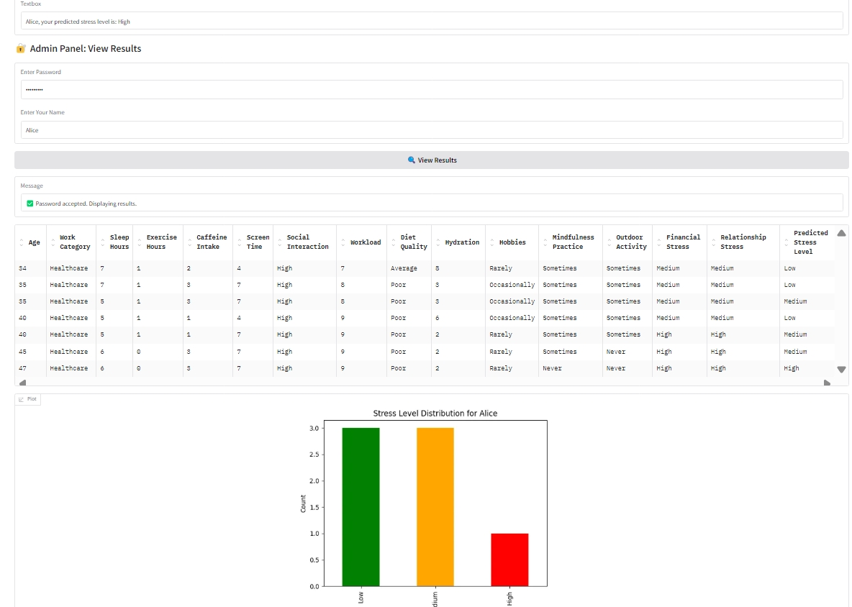
Results and Outputs

Slide 14
Conclusion
This research presented a machine learning-based system that uses the Random Forest algorithm to estimate stress levels reliably and offers tailored recommendations. It provides an approachable and user-friendly method of stress management with its straightforward Gradio interface and visible trend tracking. Building user trust and protecting data privacy are two benefits of secure user authentication. The quality of the input data determines how accurate it is, and not all users will find the advice useful. It is not a replacement for expert mental health treatment and does not integrate with real-time biometric data. Future developments can concentrate on improving clinical dependability and diversifying data sources.

Slide 15
Future Scope
Wearable Integration: Use smartwatches for real-time stress data.
Advanced AI Models: Apply deep learning for better accuracy.
NLP Chatbot: Provide personalized stress support via chat.
Mobile & Cloud Deployment: Enable easy access and long-term tracking.
Blockchain Security: Ensure secure and transparent data storage.
Multilingual & Voice Support: Make the system more user-friendly.
Professional Collaboration: Allow doctors to review and consult on reports.

Slide 16
References
C. Vuppalapati, M. S. Khan, N. Raghu, P. Veluru, and S. Khursheed, “A System to Detect Mental Stress Using Machine Learning and Mobile Development,” Proc. - Int. Conf. Machine Learning Cybern., vol. 1, pp. 161–166, 2018, Doi: 10.1109/ICMLC.2018.8527004.
P. S. A. Solanke1, Shreyash S. Tidke2, Tejas G. Malokar3, Sarvesh S. Udapurkar4, Faiz Mohammad Sheikh5 and G. Gaikwad6, “Stress Detection System Using Machine Learning,” Int. J. Res. Appl. Sci. Eng. Technol., no. February 2024.
R. Ahuja and A. Banga, “Mental stress detection in university students using machine learning algorithms,” Procedia Computer Sci., vol. 152, pp. 349–353, 2019, Doi: 10.1016/j.procs.2019.05.007.
V. M. Pramod Bobade, “Second International Conference on Inventive Research in Computing Applications (ICIRCA),” Int. Conf. Inven. Res. Computer. Appl., pp. 51–57, 2020.
A. A. Al-Atawi et al., “Stress Monitoring Using Machine Learning, IoT and Wearable Sensors,” Sensors (Basel)., vol. 23, no. 21, pp. 1–15, 2023, Doi: 10.3390/s23218875.

